Slide 1
Epigenetics and Culture
Kevin Ferriter
Mariah Minder

Slide 2
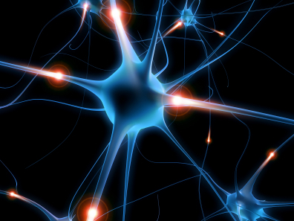
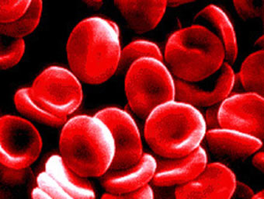
From Yesterday…
Do you think your brain cell and your blood cell have the same DNA sequence?

Slide 3
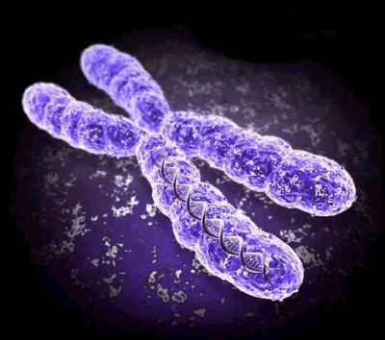
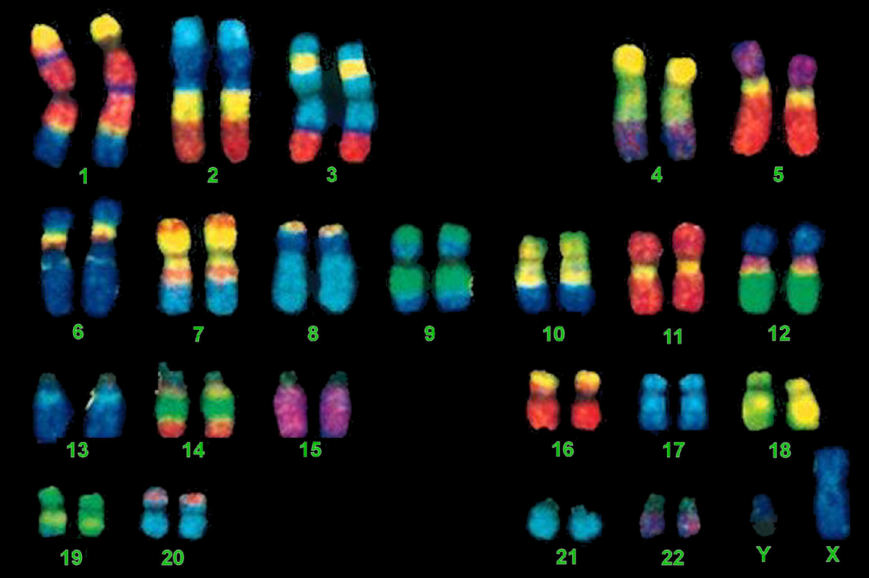
Genetics
Every cell contains all of your DNA
Not every cell expresses all of your DNA
Notes:
Enzyme only reads nucleotides for genes that are turned on.

Slide 4
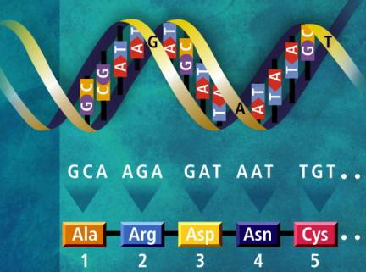
Genetics
DNA contains nucleotides which code for amino acids which eventually make a protein
Together, all of the nucleotides needed to make that protein together are a gene
Genes can be turned on or off depending on what type of cell it is and what the needs of that cell are

Slide 5
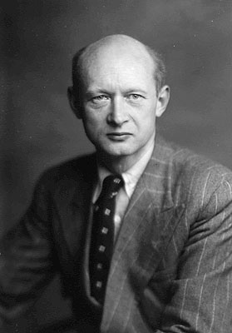
What is Epigenetics?
First studied in 1940 by C.H. Waddington
Describes how environmental influences on development can affect the phenotype of the adult
Heritable, cell-type specific and reversible
Difference between genome and epigenome

Slide 6
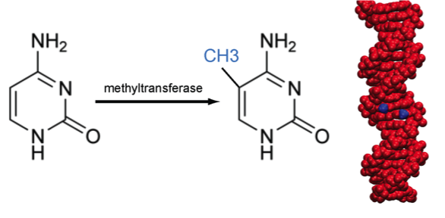
How does Epigenetics work?
Methylation
  Blocks transcription factors from binding so proteins are not made

Slide 7
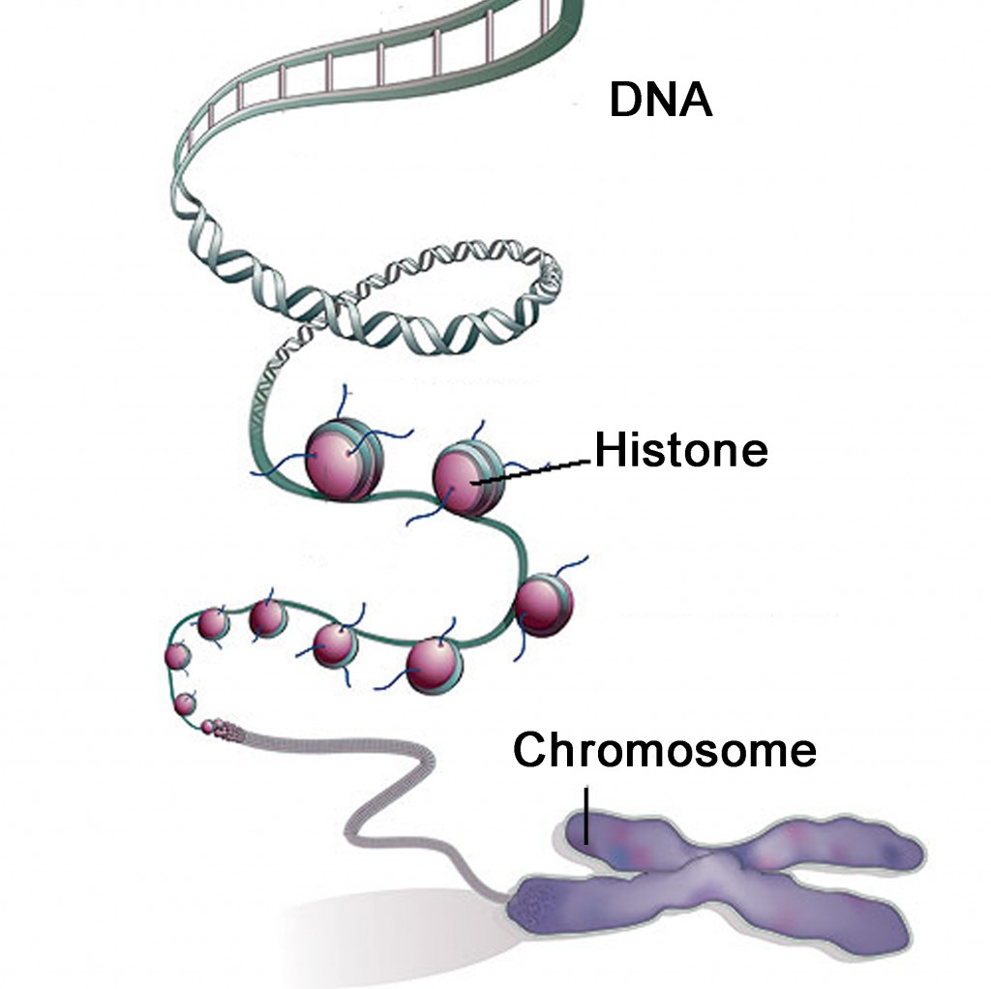
How does Epigenetics work? (cont.)
Histone Modification
  Proteins in chromosome that DNA wraps around

Slide 8
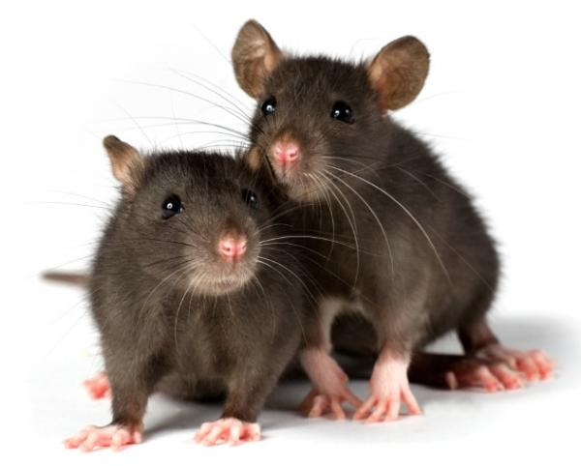
Epigenetics and Behavior
Szyf and Meaney (2004)
  The type of mothering a rat receives calibrates how its brain responds to stress throughout its life
  Glucocorticoid receptors and the stress response
Frances Champagne
  Females raised by nurturing mothers tend to be nurturing themselves
  Females raised communally are better socially adjusted as adults
  Epigenetics?

Slide 9
Epigenetics and Behavior
Roth and Sweatt (2009)
  Adverse environment can negatively affect offspring
  Offspring raised by stressed-out mothers have increased methylation of BDNF gene resulting in anxiety and depression
  Methylation pattern is passed on to subsequent generations
  “Epigenetic modifications could be an important link between adverse life experiences and the risk of psychiatric disorders.”

Slide 10
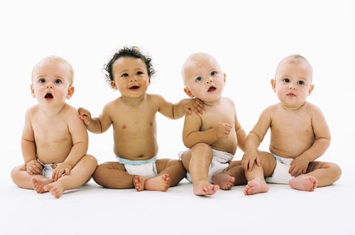
Epigenetics and Human Behavior
Very few studies
2009 study reveals increased methylation in brains of suicide victims who were abused
Problems facing human behavioral epigenetics

Slide 11
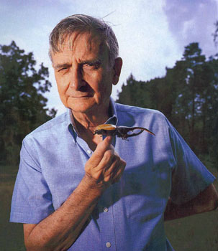
What is Human Nature?
Classical view: All social behavior is learned as a product of history
Wilson claims there is a genetic factor
“Human” traits are predictable products of something beyond genetics
Epigenetic rules that give us human traits evolved by the interaction of genetic and cultural evolution
  Obvious preferences that do not necessarily increase fitness (colors, art appreciation, attraction)

Slide 12
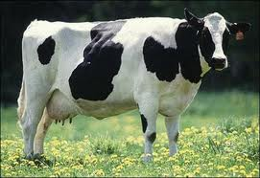

Lactose Intolerance
Lactase
  Enzyme used to digest lactose
  Originally only expressed in infants
  Cultural changes make adult production advantageous

Slide 13

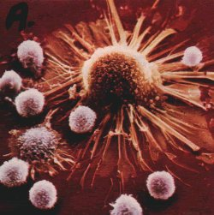
Further Examples
Incest Avoidance
Susceptibility to cancer, alcoholism, depression, anxiety

Slide 14
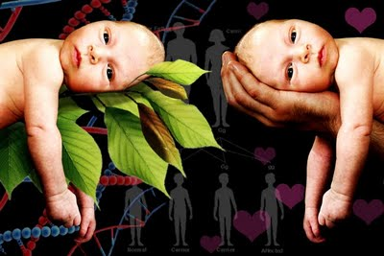
Epigenetics and Culture
Co-evolution
Nature vs. Nurture
Group selection

Slide 15
Works Consulted
Klug, W. S., Cummings, M. R., Spencer, C. A., & Palladino, M. A. (2012). Concepts of genetics. (10th ed., pp. 517-528). San Francisco, CA: Pearson.
Miller, G. (2010). The Seductive Allure of Behavioral Epigenetics. Science, 329(5987), 24-27.
Roth, T. L., Lubin, F. D., Funk, A. J., & Sweatt, J. D. (2009). Lasting epigenetic influence of early-life adversity on the BDNF gene. Biological Psychiatry, 65(9), 760-769. doi: 10.1016/j.biopsych.2008.11.028
Roth, T. L., & Sweatt, J. (2011). Epigenetic marking of the BDNF gene by early-life adverse experiences. Hormones & Behavior, 59(3), 315-320. doi:10.1016/j.yhbeh.2010.05.005
Szyf, M., & Meaney, M. J. (2008). Epigenetics, Behaviour, and Health. Allergy, Asthma & Clinical Immunology, 4(1), 37-49. doi:10.2310/7480.2008.00004
Wilson, E. O. (2012). The social conquest of earth. (1st ed., pp. 191-211). New York, NY: Liveright Publishing Co.

